Slide 1
PROJECT ENTERTAINER DATA ANALYSIS
Created by: Elizabeth Debbarma
3/7/2024

Slide 2
Introduction
This project analyzes entertainer data to uncover industry insights and trends. By examining datasets related to entertainers, we will identify keys to success, factors impacting career longevity, and the ways in which the industry is evolving. Through this analysis we hope to provide a data driven perspective on the entertainment industry and identify opportunities for growth and development. Our findings will be presented in a clear and actionable way, providing valuable insights for industry professionals, aspiring entertainers, and enthusiasts alike.

Slide 3
Given Tasks
Write the process the data added to the current dataset. Also mention the theme on which you will create a dashboard.
Add data as per your convenience
Do data preparation part
Build the Dashboard
Build a storyline.

Slide 4
Details of Data
The data was split into three parts: Entertainer Basic Info, Entertainer Breakthrough Info, and Entertainer Last Work Info.
Merged them into a single file named “Entertainer Final Data”
Given data was not sufficient for analysis part , so more information is required to add.
Number of awards and nominees won by them, awards from breakthrough performances were added to the data.
The data is in the form of numeric and alphabetic values.
Additional data was obtained from IMDb’s official website.
Source: IMDB

Slide 5


Tools Used
Excel
Tableau

Slide 6
Main KPI’s
Average movie rating of the Entertainer.
Total number of movies acted by Entertainer.
Total number of awards received by Entertainers.
Breakthrough movie of the year.
Trademarks of the Entertainer.

Slide 7
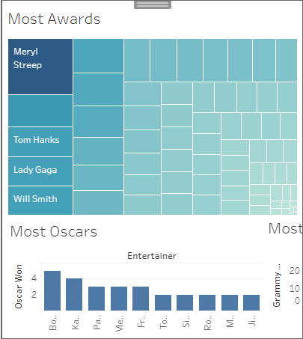
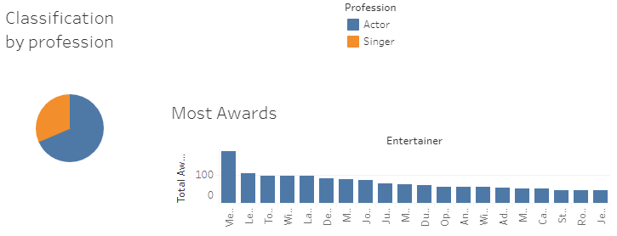
Dashboard 1

Slide 8
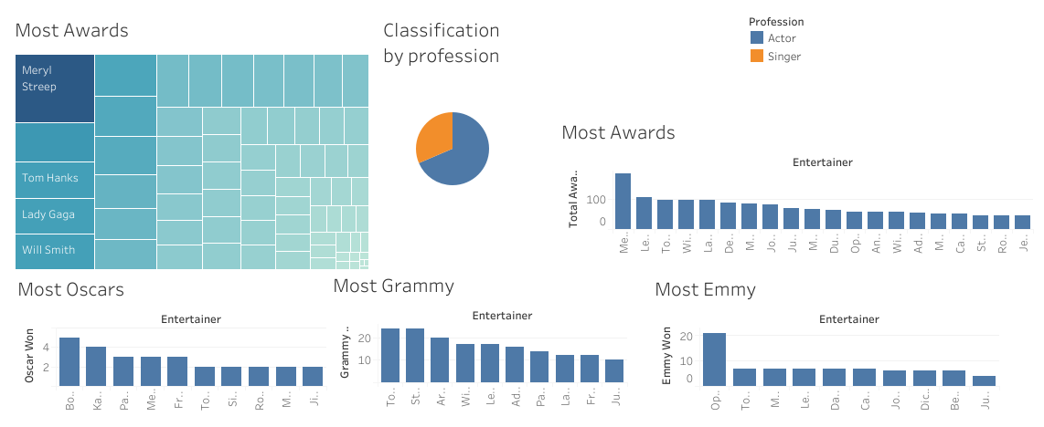
Dashboard 2

Slide 9
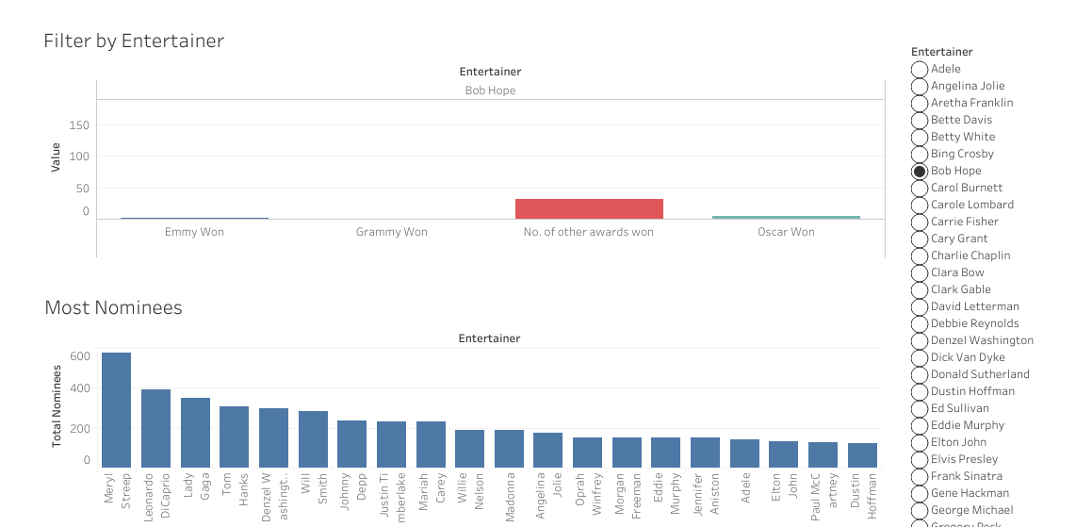
Dashboard 3

Slide 10
Thank you

